Slide 1
CSE450
Data Mining
Week 4:
  Over fitting
  Evaluation: accuracy, precision, recall, ROC

Slide 2
Practical Issues of Classification
Underfitting and Overfitting
Missing Values
Costs of Classification
CSEDIU

Slide 3
DTs in practice...
Growing to purity is bad (overfitting)
x2: sepal width
x1: petal length
CSEDIU

Slide 4
DTs in practice...
Growing to purity is bad (overfitting)
x2: sepal width
x1: petal length
CSEDIU

Slide 5
DTs in practice...
Growing to purity is bad (overfitting)
  Terminate growth early
  Grow to purity, then prune back
CSEDIU

Slide 6
DTs in practice...
Growing to purity is bad (overfitting)
Not statistically
supportable leaf
x2: sepal width
Remove split
& merge leaves
x1: petal length
CSEDIU

Slide 7
Training and Test Set
For classification problems, we measure the performance of a model in terms of its error rate: percentage of incorrectly classified instances in the data set.
We build a model because we want to use it to classify new data. Hence we are chiefly interested in model performance on new (unseen) data.
The resubstitution error (error rate on the training set) is a bad predictor of performance on new data.
The model was build to account for the training data, so might overfit it, i.e., not generalize to unseen data.
CSEDIU

Slide 8

Underfitting and Overfitting
Overfitting
= model complexity (the issue of overfitting is important for classification in general not only for decision trees)
Underfitting: when model is too simple, both training and test errors are large
Overfitting: when model is too complex, training errors is getting small while test errors are large
CSEDIU

Slide 9
Overfitting (another view)
Learning a tree that classifies the training data perfectly may not lead to the tree with the best generalization to unseen data.
  There may be noise in the training data that the tree is erroneously fitting.
  The algorithm may be making poor decisions towards the leaves of the tree that are based on very little data and may not reflect reliable trends.
on training data
on test data
accuracy
hypothesis complexity/size of the tree (number of nodes)
CSEDIU

Slide 10

Overfitting due to Noise
Decision boundary is distorted by noise point
CSEDIU

Slide 11

Overfitting due to Insufficient Examples
Lack of data points in the lower half of the diagram makes it difficult to predict correctly the class labels of that region
- Insufficient number of training records in the region causes the decision tree to predict the test examples using other training records that are irrelevant to the classification task
CSEDIU

Slide 12
Overfitting Example
The issue of overfitting had been known long before decision trees and data mining
In electrical circuits, Ohm's law states that the current through a conductor between two points is directly proportional to the potential difference or voltage across the two points, and inversely proportional to the resistance between them.
Experimentally
measure 10 points
Fit a curve to the
Resulting data.
current (I)
voltage (V)
Perfect fit to training data with an 9th degree polynomial
(can fit n points exactly with an n-1 degree polynomial)
Ohm was wrong, we have found a more accurate function!
CSEDIU

Slide 13
Overfitting Example
Testing Ohms Law: V = IR (I = (1/R)V)
current (I)
voltage (V)
Better generalization with a linear function
that fits training data less accurately.
CSEDIU

Slide 14
Notes on Overfitting
Overfitting results in decision trees that are more complex than necessary
Training error no longer provides a good estimate of how well the tree will perform on previously unseen records
Need new ways for estimating errors
CSEDIU

Slide 15
How to avoid overfitting?
Stop growing the tree before it reaches the point where it perfectly classifies the training data (prepruning)
  Such estimation is difficult
Allow the tree to overfit the data, and then post-prune the tree (postpruning)
  Is used
Although first approach is more direct, second approach found more successful in practice: because it is difficult to estimate when to stop
Both need a criterion to determine final tree size
CSEDIU

Slide 16
Occam’s Razor
Given two models of similar errors, one should prefer the simpler model over the more complex model
For complex models, there is a greater chance that it was fitted accidentally by errors in data
Therefore, one should include model complexity when evaluating a model
CSEDIU

Slide 17
How to Address Overfitting
Pre-Pruning (Early Stopping Rule)
  Stop the algorithm before it becomes a fully-grown tree
  Typical stopping conditions for a node:
    Stop if all instances belong to the same class
    Stop if all the attribute values are the same
  More restrictive conditions:
    Stop if number of instances is less than some user-specified threshold
    Stop if class distribution of instances are independent of the available features (e.g., using χ ² test)
    Stop if expanding the current node does not improve impurity
    measures (e.g., Gini or information gain).
CSEDIU

Slide 18
How to Address Overfitting…
Post-pruning
  Grow decision tree to its entirety
  Trim the nodes of the decision tree in a bottom-up fashion
  If generalization error improves after trimming, replace sub-tree by a leaf node.
  Class label of leaf node is determined from majority class of instances in the sub-tree
  Can use MDL for post-pruning
CSEDIU

Slide 19
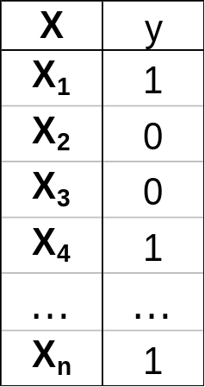
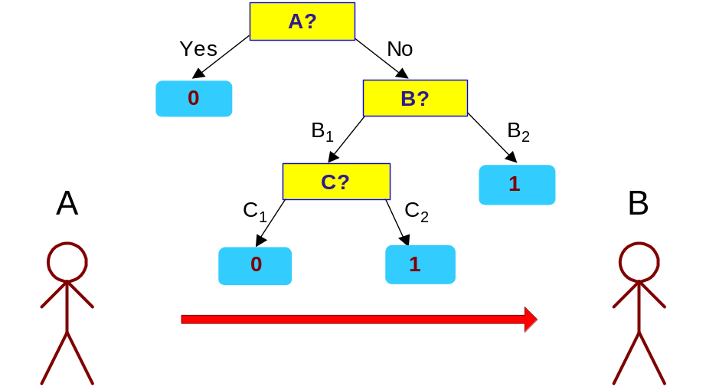
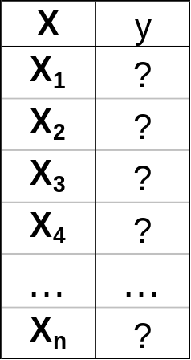
Minimum Description Length (MDL)
Cost(Model,Data) = Cost(Data|Model) + Cost(Model)
  Cost is the number of bits needed for encoding.
  Search for the least costly model.
Cost(Data|Model) encodes the misclassification errors.
Cost(Model) uses node encoding (number of children) plus splitting condition encoding.
CSEDIU

Slide 20
Criterion to Determine
Correct Tree Size
Training and Validation Set Approach:
  Use a separate set of examples, distinct from the training examples, to evaluate the utility of post-pruning nodes from the tree.
Use all available data for training,
  but apply a statistical test (Chi-square test) to estimate whether expanding (or pruning) a particular node is likely to produce an improvement.
Use an explicit measure of the complexity
  for encoding the training examples and the decision tree,
  halting growth when this encoding size is minimized.
CSEDIU

Slide 21
Validation Set
Provides a safety check against overfitting spurious characteristics of data
Needs to be large enough to provide a statistically significant sample of instances
Typically validation set is one half size of training set
Reduced Error Pruning: Nodes are removed only if the resulting pruned tree performs no worse than the original over the validation set.
CSEDIU

Slide 22
Reduced Error Pruning Properties
When pruning begins tree is at maximum size and lowest accuracy over test set
As pruning proceeds no of nodes is reduced and accuracy over test set increases
Disadvantage: when data is limited, no of samples available for training is further reduced
  Rule post-pruning is one approach
  Alternatively, partition available data several times in multiple ways and then average the results
CSEDIU

Slide 23
Issues with Reduced Error Pruning
The problem with this approach is that it potentially “wastes” training data on the validation set.
Severity of this problem depends where we are on the learning curve:
test accuracy
number of training examples
CSEDIU

Slide 24
Rule Post-Pruning (C4.5)
Convert the decision tree into an equivalent set of rules.
Prune (generalize) each rule by removing any preconditions so that the estimated accuracy is improved.
Sort the prune rules by their estimate accuracy, and apply them in this order when classifying new samples.
CSEDIU

Slide 25
Model Evaluation
Metrics for Performance Evaluation
  How to evaluate the performance of a model?
Methods for Performance Evaluation
  How to obtain reliable estimates?
CSEDIU

Slide 26
Metrics for Performance Evaluation
Focus on the predictive capability of a model
  Rather than how fast it takes to classify or build models, scalability, etc.
Confusion Matrix:
 | PREDICTED CLASS
ACTUAL CLASS |  | Class=Yes | Class=No
 | Class=Yes | a | b
 | Class=No | c | d
a: TP (true positive)
b: FN (false negative)
c: FP (false positive)
d: TN (true negative)
CSEDIU

Slide 27
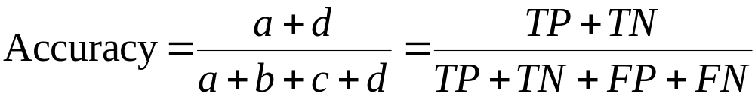
Metrics for Performance Evaluation…
 | PREDICTED CLASS
ACTUAL CLASS |  | Class=P | Class=N
 | Class=P | a (TP) | b (FN)
 | Class=N | c (FP) | d (TN)
Most widely-used metric:
Error Rate = 1 - accuracy
CSEDIU

Slide 28
Limitation of Accuracy
Consider a 2-class problem
  Number of Class 0 examples = 9990
  Number of Class 1 examples = 10
If model predicts everything to be class 0, accuracy is 9990/10000 = 99.9 %
  Accuracy is misleading because model does not detect any class 1 example
CSEDIU

Slide 29
Measuring predictive ability
Can count number (percent) of correct predictions or errors
  in Weka “percent correctly classified instances”
In business applications, different errors (different decisions) have different costs and benefits associated with them
Usually need either to rank cases or to compute probability of the target (class probability estimation rather than just classification)
CSEDIU

Slide 30
Costs Matter
The error rate is an inadequate measure of the performance of an algorithm, it doesn’t take into account the cost of making wrong decisions.
Example: Based on chemical analysis of the water try to detect an oil slick in the sea.
  False positive: wrongly identifying an oil slick if there is none.
  False negative: fail to identify an oil slick if there is one.
Here, false negatives (environmental disasters) are much more costly than false negatives (false alarms). We have to take that into account when we evaluate our model.
CSEDIU

Slide 31
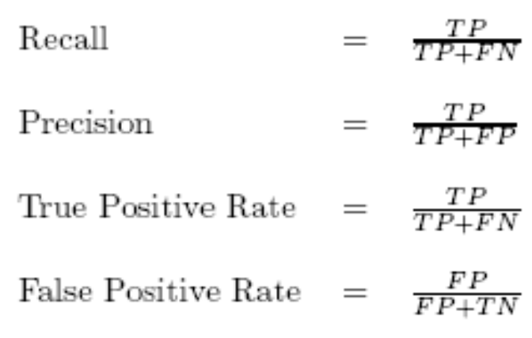
Precision and Recall
 | Positive (+) | Negative (-)
Predicted positive (Y) | TP | FP
Predicted negative (N) | FN | TN
Recall versus precision trade-off
CSEDIU

Slide 32
Cost Matrix
 | PREDICTED CLASS
ACTUAL CLASS | C(i|j) | Class=Yes | Class=No
 | Class=Yes | C(Yes|Yes) | C(No|Yes)
 | Class=No | C(Yes|No) | C(No|No)
C(i|j): Cost of misclassifying class j example as class i
CSEDIU

Slide 33
Computing Cost of Classification
Cost Matrix | PREDICTED CLASS
ACTUAL CLASS | C(i|j) | + | -
 | + | -1 | 100
 | - | 1 | 0
Model M₁ | PREDICTED CLASS
ACTUAL CLASS |  | + | -
 | + | 150 | 40
 | - | 60 | 250
Model M₂ | PREDICTED CLASS
ACTUAL CLASS |  | + | -
 | + | 250 | 45
 | - | 5 | 200
Accuracy = 80%
Cost = 3910
Accuracy = 90%
Cost = 4255
CSEDIU

Slide 34
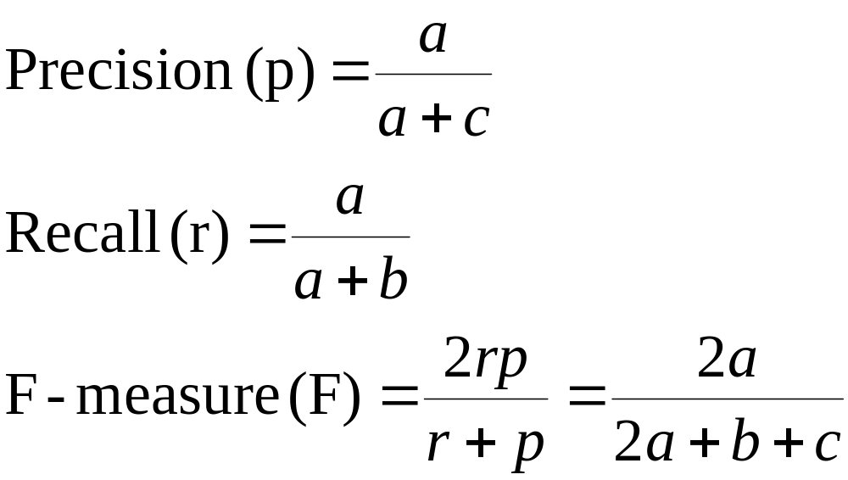
Cost-Sensitive Measures
 | PREDICTED CLASS
ACTUAL CLASS |  | Class=Yes | Class=No
 | Class=Yes | a (TP) | b (FN)
 | Class=No | c (FP) | d (TN)

Slide 35
Problems
What if you can’t estimate accurately or precisely the costs, benefits, or target conditions (viz., percentage of + or – in target population)?
Suppose there are 1000 cases, 995 of which are negative cases and 5 of which are positive cases. If the system classifies them all as negative, the accuracy would be 99.5%, even though the classifier missed all positive cases.
Is accuracy a good measure for highly skewed data set?
ROC curves
  In signal detection theory, a receiver operating characteristic (ROC), or simply ROC curve, is a graphical plot of the fraction of true positives (TPR = true positive rate) vs. the fraction of false positives (FPR = false positive rate).
Report false positives and false negatives
CSEDIU

Slide 36
Model Evaluation
Metrics for Performance Evaluation
  How to evaluate the performance of a model?
Methods for Performance Evaluation
  How to obtain reliable estimates?
Methods for Model Comparison
  How to compare the relative performance among competing models?
CSEDIU

Slide 37
Classifiers
A classifier assigns an object to one of a predefined set of categories or classes.
Examples:
  A metal detector either sounds an alarm or stays quiet when someone walks through.
  A credit card application is either approved or denied.
  A medical test’s outcome is either positive or negative.
This talk: only two classes, “positive” and “negative”.
CSEDIU

Slide 38
Some Terms
 |  | MODEL PREDICTED
 |  | NO EVENT | EVENT
GOLD STANDARD TRUTH | NO EVENT | TRUE NEGATIVE | B
 | EVENT | C | TRUE POSITIVE

Slide 39
Some More Terms
Two types of errors:
False positive (“false alarm”), FP alarm sounds but person is not carrying metal
False negative (“miss”), FN alarm doesn’t sound but person is carrying metal
 |  | MODEL PREDICTED
 |  | NO EVENT | EVENT
GOLD STANDARD TRUTH | NO EVENT | A | FALSE POSITIVE (Type 1 Error)
 | EVENT | FALSE NEGATIVE (Type 2 Error) | D

Slide 40
2-class Confusion Matrix
True class | Predicted class
 | positive | negative
positive (#P) | #TP | #P - #TP
negative (#N) | #FP | #N - #FP
Reduce the 4 numbers to two rates
  true positive rate = TP = (#TP)/(#P)
  false positive rate = FP = (#FP)/(#N)
Rates are independent of class ratio*
CSEDIU

Slide 41
Example: 3 classifiers
True | Predicted
 | pos | neg
pos | 40 | 60
neg | 30 | 70
True | Predicted
 | pos | neg
pos | 70 | 30
neg | 50 | 50
True | Predicted
 | pos | neg
pos | 60 | 40
neg | 20 | 80
Classifier 1
TP = 0.4
FP = 0.3
Classifier 2
TP = 0.7
FP = 0.5
Classifier 3
TP = 0.6
FP = 0.2
CSEDIU

Slide 42
Assumptions
Standard Cost Model
  correct classification costs 0
  cost of misclassification depends only on the class, not on the individual example
  over a set of examples costs are additive
Costs or Class Distributions:
  are not known precisely at evaluation time
  may vary with time
  may depend on where the classifier is deployed
True FP and TP do not vary with time or location, and are accurately estimated.
CSEDIU

Slide 43
How to Evaluate Performance ?
Scalar Measures
  Accuracy
  Expected cost
  Area under the ROC curve
Visualization Techniques
  ROC curves
  Cost Curves
CSEDIU

Slide 44
What’s Wrong with Scalars ?
A scalar does not tell the whole story.
  There are fundamentally two numbers of interest (FP and TP), a single number invariably loses some information.
  How are errors distributed across the classes ?
  How will each classifier perform in different testing conditions (costs or class ratios other than those measured in the experiment) ?
A scalar imposes a linear ordering on classifiers.
  what we want is to identify the conditions under which each is better.
Why Performance evaluation is useful
  Shape of curves more informative than a single number
CSEDIU

Slide 45
ROC Curves
Receiver operator characteristic
Summarize & present performance of any binary classification model
Models ability to distinguish between false & true positives
CSEDIU

Slide 46
Receiver Operating Characteristic Curve (ROC) Analysis
Signal Detection Technique
Traditionally used to evaluate diagnostic tests
Now employed to identify subgroups of a population at differential risk for a specific outcome (clinical decline, treatment response)
Identifies moderators
CSEDIU

Slide 47
ROC Analysis:
Historical Development (1)
Derived from early radar in WW2 Battle of Britain to address: Accurately identifying the signals on the radar scan to predict the outcome of interest – Enemy planes – when there were many extraneous signals (e.g. Geese)?
CSEDIU
Notes:
1. ROC is a signal detection technique (Exploratory or hypothesis generating)
2. Traditionally most use of it is in evaluation of medical tests: refer to helens book
3. Very easy to understand the ROC through the idea of how well a diagnositc test identifes an illness.
4. But of course it is not restricted to test evaluation
5. Same technique can be Also used outcome of many sorts etc.
Where we think of diagnostic test=predictor
Disease=outcome of interest (Binary outcome)
SO WHY NOT DO A SIMPLE LOGISTIC REGRESSION WHICH IS A REGRESSION WHICH CAN DEAL WITH BINARY OUTCOMES?
Great article by Helena, etc.comparing logistic regression and ROC analysis entilted

Slide 48
ROC Analysis:
Historical Development (2)
True Positives = Radar Operator interpreted signal as Enemy Planes and there were Enemy planes (Good Result: No wasted Resources)
True Negatives = Radar Operator said no planes and there were none (Good Result: No wasted resources)
False Positives = Radar Operator said planes, but there were none (Geese: wasted resources)
False Negatives = Radar Operator said no plane, but there were planes (Bombs dropped: very bad outcome)
CSEDIU
Notes:
Hand out handout on these

Slide 49
True/False Positive Rate
Sample contingency tables from range of threshold/probability.
TRUE POSITIVE RATE (also called SENSITIVITY)
True Positives
(True Positives) + (False Negatives)
FALSE POSITIVE RATE (also called 1 - SPECIFICITY)
False Positives
(False Positives) + (True Negatives)
Plot Sensitivity vs. (1 – Specificity) for sampling and you are done
Computer the area under the curve → model performance measure
CSEDIU

Slide 50
Example: 3 classifiers
True | Predicted
 | pos | neg
pos | 40 | 60
neg | 30 | 70
True | Predicted
 | pos | neg
pos | 70 | 30
neg | 50 | 50
True | Predicted
 | pos | neg
pos | 60 | 40
neg | 20 | 80
Classifier 1
TP = 0.4
FP = 0.3
Classifier 2
TP = 0.7
FP = 0.5
Classifier 3
TP = 0.6
FP = 0.2
CSEDIU

Slide 51
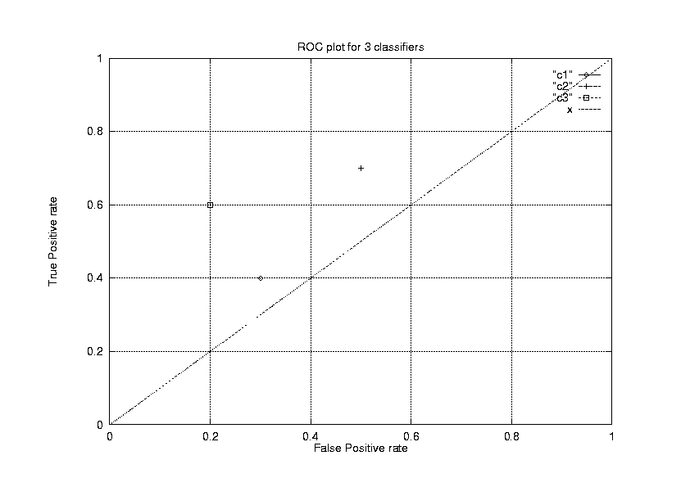
ROC plot for the 3 Classifiers
Ideal classifier
always positive
chance
always negative
CSEDIU

Slide 52
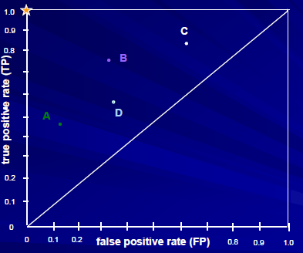
ROC Space
“Receiver Operating Characteristic” analysis (from signal detection theory)
Each classifier is represented by plotting its (FP,TP) pair
Not sensitive to different class distributions (% + and % -)
What does the diagonal line represent?
CSEDIU

Slide 53
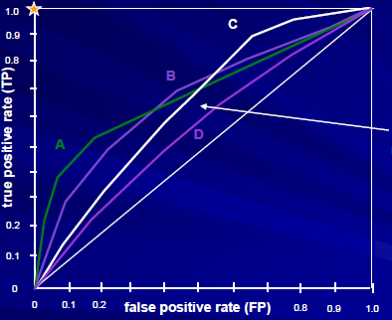
ROC Curves
more generally, ranking
models produce a
range of possible (FP,TP)
tradeoffs
Separates classifier performance from costs, benefits and target class distributions
Generated by starting with best “rule” and progressively adding more rules
Last case is when always predict positive class and TP =1 and FP = 1
CSEDIU

Slide 54
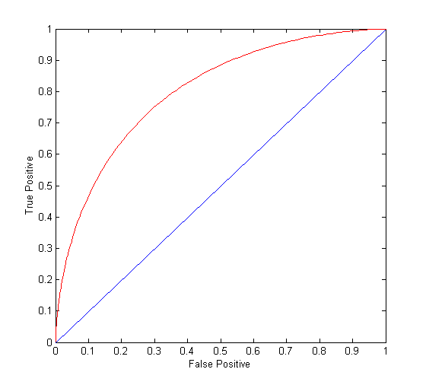
ROC Curve
(TP,FP):
(0,0): declare everything
to be negative class
(1,1): declare everything
to be positive class
(1,0): ideal
Diagonal line:
  Random guessing
  Below diagonal line:
    prediction is opposite of the true class
CSEDIU

Slide 55
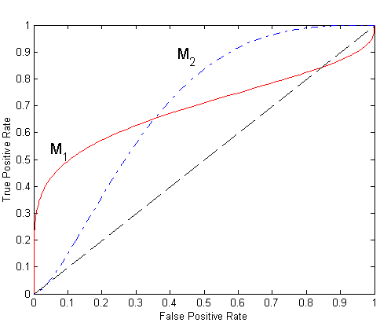
Using ROC for Model Comparison
No model consistently outperform the other
  M₁ is better for small FPR
  M₂ is better for large FPR
Area Under the ROC curve
  Ideal:
    Area = 1
  Random guess:
    Area = 0.5
CSEDIU

Slide 56
Model Evaluation
Metrics for Performance Evaluation
  How to evaluate the performance of a model?
Methods for Performance Evaluation
  How to obtain reliable estimates?
CSEDIU

Slide 57
Methods for Performance Evaluation
How to obtain a reliable estimate of performance?
Performance of a model may depend on other factors besides the learning algorithm:
  Class distribution
  Cost of misclassification
  Size of training and test sets
CSEDIU

Slide 58
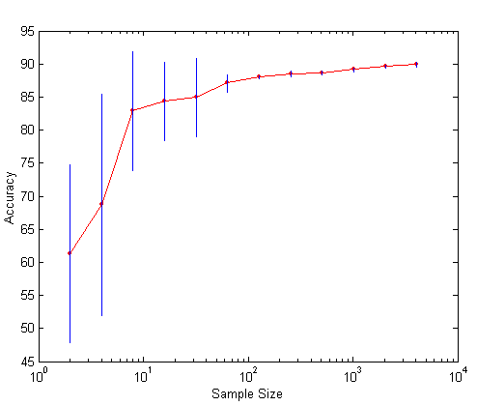
Learning Curve
Learning curve shows how accuracy changes with varying sample size
Requires a sampling schedule for creating learning curve:
  Arithmetic sampling
  (Langley, et al)
  Geometric sampling
  (Provost et al)
CSEDIU

Slide 59
Methods of Estimation
Holdout
  Reserve 2/3 for training and 1/3 for testing
Random subsampling
  Repeated holdout
Cross validation
  Partition data into k disjoint subsets
  k-fold: train on k-1 partitions, test on the remaining one
  Leave-one-out: k=n
CSEDIU

Slide 60
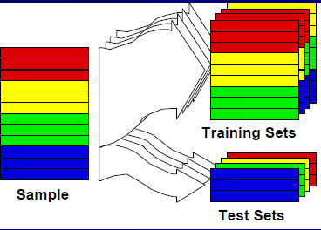
Holdout validation: Cross-validation (CV)
Partition data into k “folds” (randomly)
Run training/test evaluation k times
CSEDIU

Slide 61
Cross Validation
Example: data set with 20 instances, 5-fold cross validation
training | test
d₁ | d₂ | d₃ | d₄
d₅ | d₆ | d₇ | d₈
d₉ | d₁₀ | d₁₁ | d₁₂
d₁₃ | d₁₄ | d₁₅ | d₁₆
d₁₇ | d₁₈ | d₁₉ | d₂₀
d₁ | d₂ | d₃ | d₄
d₅ | d₆ | d₇ | d₈
d₉ | d₁₀ | d₁₁ | d₁₂
d₁₃ | d₁₄ | d₁₅ | d₁₆
d₁₇ | d₁₈ | d₁₉ | d₂₀
d₁ | d₂ | d₃ | d₄
d₅ | d₆ | d₇ | d₈
d₉ | d₁₀ | d₁₁ | d₁₂
d₁₃ | d₁₄ | d₁₅ | d₁₆
d₁₇ | d₁₈ | d₁₉ | d₂₀
compute error rate for each fold →
then compute average error rate
d₁ | d₂ | d₃ | d₄
d₅ | d₆ | d₇ | d₈
d₉ | d₁₀ | d₁₁ | d₁₂
d₁₃ | d₁₄ | d₁₅ | d₁₆
d₁₇ | d₁₈ | d₁₉ | d₂₀
d₁ | d₂ | d₃ | d₄
d₅ | d₆ | d₇ | d₈
d₉ | d₁₀ | d₁₁ | d₁₂
d₁₃ | d₁₄ | d₁₅ | d₁₆
d₁₇ | d₁₈ | d₁₉ | d₂₀
Can you average trees?
Solution?
CSEDIU

Slide 62
Leave-one-out Cross Validation
Leave-one-out cross validation is simply k-fold cross validation with k set to n, the number of instances in the data set.
The test set only consists of a single instance, which will be classified either correctly or incorrectly.
Advantages: maximal use of training data, i.e., training on n−1 instances. The procedure is deterministic, no sampling involved.
Disadvantages: unfeasible for large data sets: large number of training runs required, high computational cost.
CSEDIU

